Slide 1
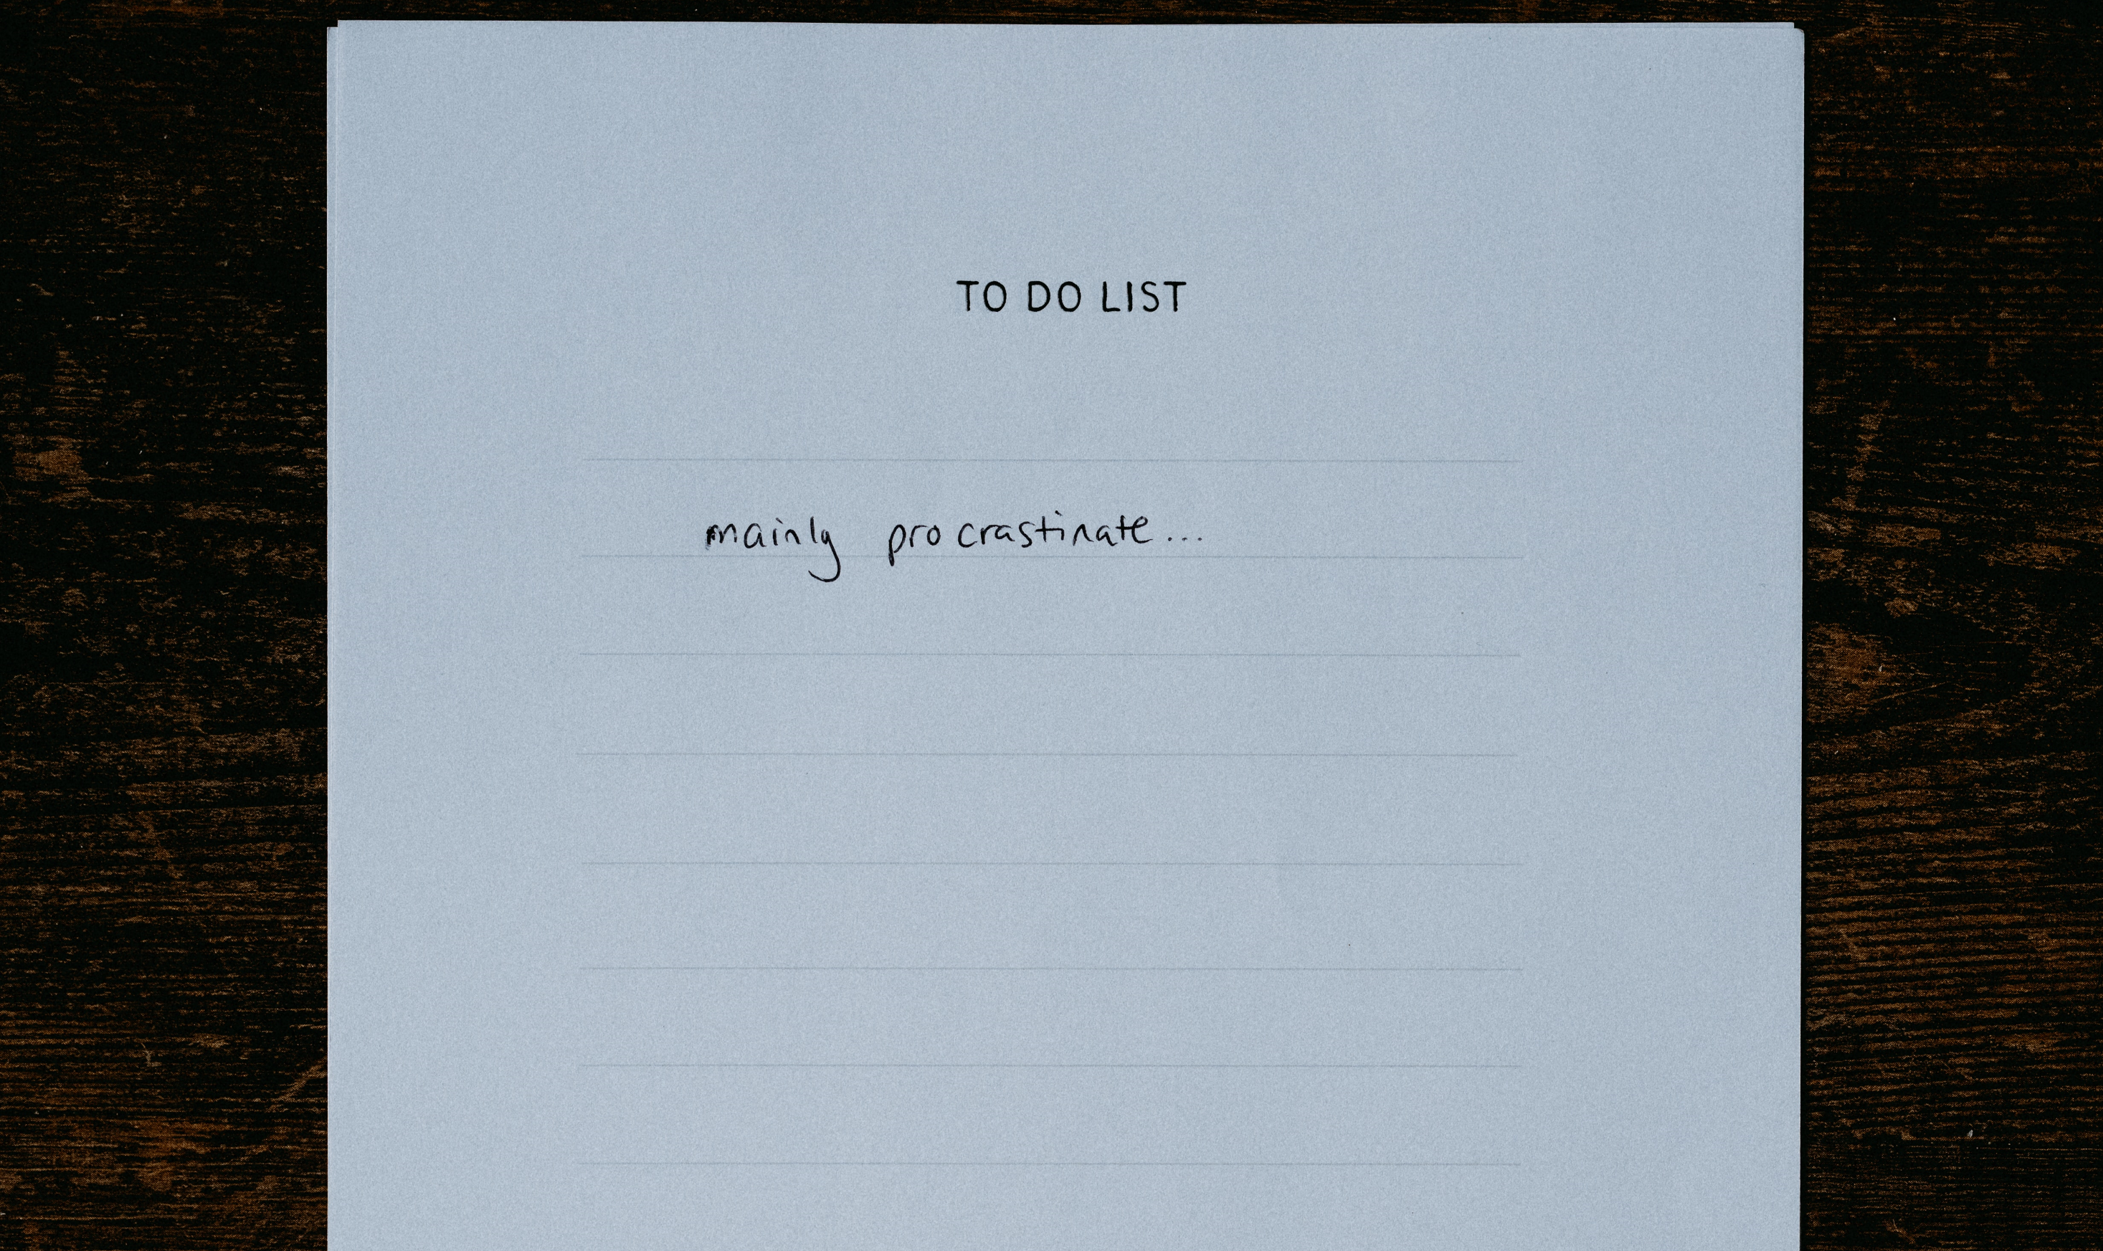
End procrastination (tomorrow)
William Brander
@williambza
Particular Software
How doing things later can make your systems better

Slide 2

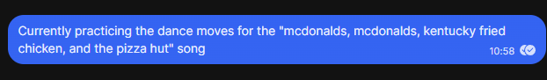
Who am I?
William Brander
@williambza
Particular Software
Chief Procrastinating Officer* at Particular Software
*This is a made-up title

Slide 3

Procrastionation:
noun –
A putting off to a future time; delay; dilatoriness

Slide 4

Precrastionation:
noun –
The completion of a task too quickly or too early for the optimal outcome; the compulsion to act in this way

Slide 5
Laziness:
noun –
Disinclined to action or exertion; naturally or habitually slothful; sluggish; indolent; averse to labour.
// todo: find a picture for laziness

Slide 6

Procrastination
Precrastination
Laziness
Putting things off until later
Doing things before they are needed
Not doing things

Slide 7


Slide 8
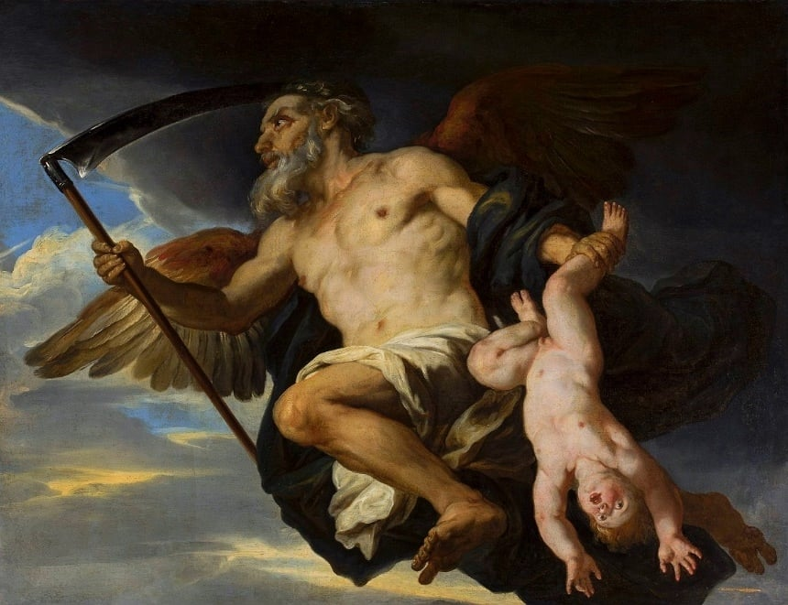
Notes:
In Greek mythology, Cronus (also spelt Kronos) is a Titan and the youngest son of Uranus (Heaven/Sky) and Gaia (Earth). He dethroned Uranus and became the world's first king, ruling over his siblings and fellow Titans. Cronus married his sister Rhea and was eventually overthrown by his son Zeus.
Cronus was cursed to travel the world and measure out eternity all alone. He was therefore known as 'Old Father Time.' He began to age, reminding everyone of the relentless passing of time that would eventually drive all mortals to the end of their days.
https://www.worldhistory.org/Cronus/

Slide 9
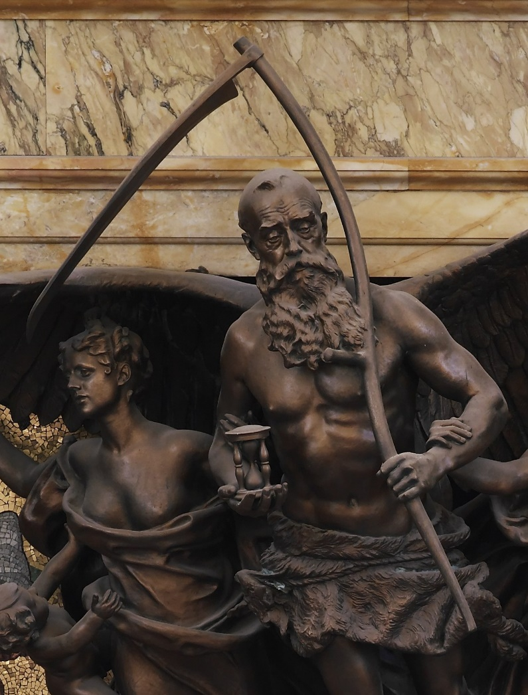

Slide 10


Slide 11


Slide 12
void CheckOutRental(Guid movieId, Guid customerId)
{
var rental = new Rental(movieId, customerId);
rental.ReturnDate = DateTime.UtcNow.AddDays(3);
database.Rentals().Add(rental);
database.Save();
}

Slide 13
Lazy, pre, or pro?
void ChargeLateFees()
{
var lateRentals = database.Rentals()
.Where(rental => rental.ReturnDate < DateTime.UtcNow
&& !rental.Returned);
foreach (rental in lateRentals)
{
rental.LateFees += 50;
}
database.Save();
}

Slide 14
ChargeLateFees()
ChargeLateFees()
09:41 – Rental officially
becomes “late”
14:34 – Customer
returns rental
09:00
10:00
11:00
12:00
13:00
14:00
15:00
16:00
17:00

Slide 15

Let’s procrastinate!
void CheckOutRental(Guid movieId, Guid customerId)
{
var rental = new Rental(movieId, customerId);
RequestTimeout(
new RentalIsLate(rental.Id),
DateTime.UtcNow.AddDays(3)
);
database.Rentals().Add(rental);
database.Save();
}
void CheckOutRental(Guid movieId, Guid customerId)
{
var rental = new Rental(movieId, customerId);
rental.ReturnDate = DateTime.UtcNow.AddDays(3);
database.Rentals().Add(rental);
database.Save();
}

Slide 16
void Handle(RentalIsLate rentalId)
{
var rental = database.Rentals(rentalId);
if (rental.Returned)
return;
rental.LateFees += 50;
RequestTimeout(
new RentalIsLate(rentalId),
DateTime.UtcNow.AddHours(6)
);
database.Save();
}
void Handle(RentalIsLate rentalId)
{
var rental = database.Rentals(rentalId);
if (rental.Returned)
return;
rental.LateFees += 50;
database.Save();
}

Slide 17

Handle(rentalId)
Handle(rentalId)
09:00
10:00
11:00
12:00
13:00
14:00
15:00
16:00
17:00
09:41 – Rental officially
becomes “late”
14:34 – Customer
returns rental

Slide 18
void ChargeLateFees()
{
var lateRentals = database.Rentals()
.Where(rental => rental.ReturnDate < DateTime.UtcNow
&& !rental.Returned);
foreach (rental in lateRentals)
{
rental.LateFees += 50;
}
database.Save();
}
void Handle(RentalIsLate rentalId)
{
var rental = database.Rentals(rentalId);
if (rental.Returned)
return;
rental.LateFees += 50;
RequestTimeout(
new RentalIsLate(rentalId),
DateTime.UtcNow.AddHours(6)
);
database.Save();
}

Slide 19

First procrastination technique
Time can be your friend, let it tell you when to do things

Slide 20
…ok, but, like… how?

Slide 21
Polling a Database table

Slide 22
Native broker support
async Task RequestTimeout(ReduceWeeklyAmount reduce, DateTime when)
{
ServiceBusSender sender = client.CreateSender(topicName);
ServiceBusMessage message = new ServiceBusMessage(reduce);
message.ScheduledEnqueueTime = when;
await sender.SendMessageAsync(message);
}

Slide 23
Dead letter exchanges
Routing keys:
x.x.x.x.x.x.x.x.x.x.x.x.x.x.x.x.x.x.x.x.x
2^{n-1}
1 second :
0.0.0.0.0.0.0.0.0.0.0.0.0.0.0.0.0.0.0.0.1
1 Day = 86 400 seconds :
0.0.0.0.1.0.1.0.1.0.0.0.1.1.0.0.0.0.0.0.0
1 Week = 604 800 seconds :
0.1.0.0.1.0.0.1.1.1.0.1.0.1.0.0.0.0.0.0.0

Slide 24
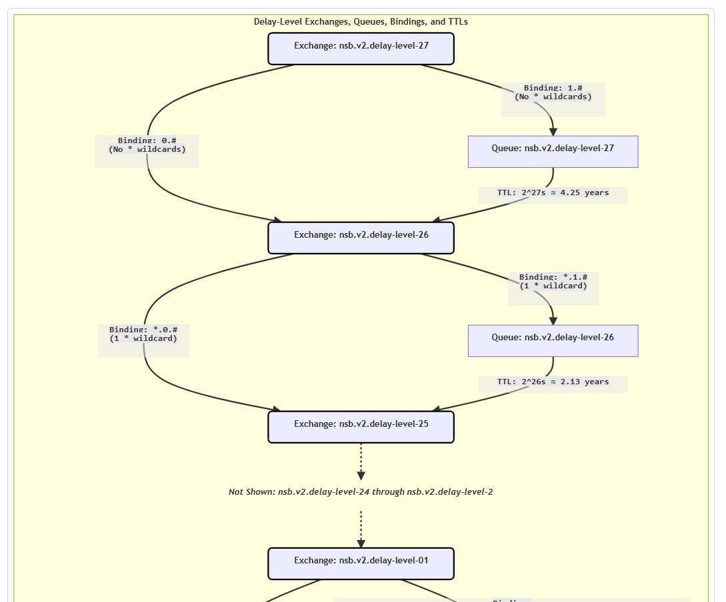

Dead letter exchanges

Slide 25
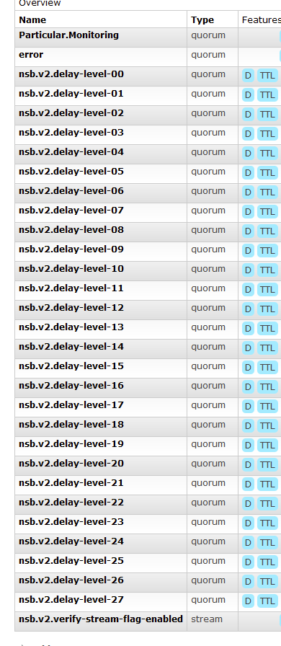
Dead letter exchanges

Slide 26
void Handle(RentalIsLate rentalId)
{
var rental = database.Rentals(rentalId);
if (rental.Returned)
return;
rental.LateFees += 50;
RequestTimeout(
new RentalIsLate(rentalId),
DateTime.UtcNow.AddHours(6)
);
database.Save();
}

Slide 27
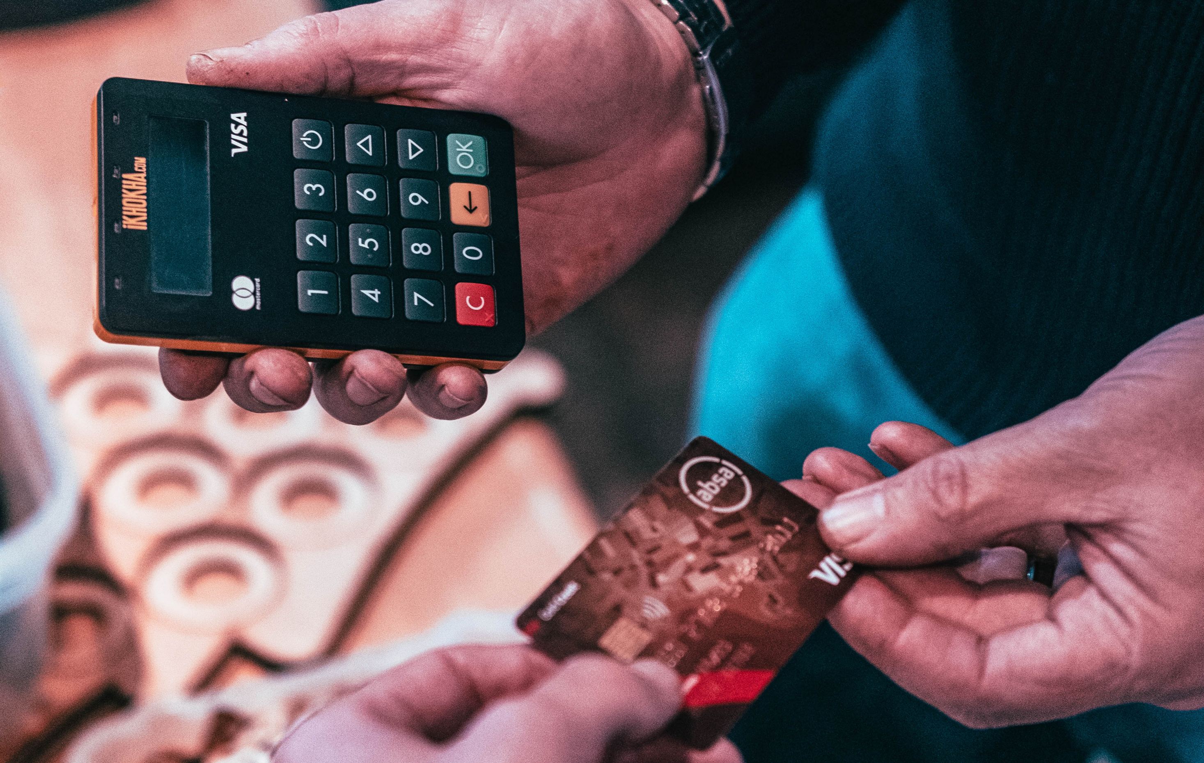

Slide 28
The timeouts and business data must share the same transaction
Must only be successfully processed exactly once
Must be able to be retried

Slide 29


Slide 30
Customer status – Lazy, pre, or pro?
void UpdateCustomerStatus()
{
DateTime cutoff = DateTime.Today.AddDays(-365);
foreach (var customer in customers)
{
var rentalTotal = customer.Rentals
.Where(r => r.RentalDate > cutoff)
.Sum(rental => rental.TotalCost);
customer.Preferred = rentalTotal >= 5000;
}
}

Slide 31
Precrastinated version
void Handle(RentalPlaced rental)
{
var customer = GetCustomer(rental.CustomerId);
var rentalTotal = customer.Rentals
.Where(r => r.RentalDate > cutoff)
.Sum(rental => rental.RentalValue);
customer.Preferred = rentalTotal >= 5000;
[…snip…] // do the rest of the rental
}

Slide 32
Monthly Invoices
foreach (var customer in customers)
{
var invoiceFileLocation = GenerateInvoice(customer, DateTime.Today.Month);
EmailFile(invoiceFileLocation, customer.EmailAddress);
}

Slide 33
void Handle(CustomerRegistered customer)
{
RequestTimeout(
new SendMonthlyInvoice(customer.Id),
DateTime.UtcNow.AtMonthEnd()
);
}
void Handle(SendMonthlyInvoice customerId)
{
var customer = GetCustomer(customerId);
var invoiceFileLocation = GenerateInvoice(customer, DateTime.Today.Month);
EmailFile(invoiceFileLocation, customer.EmailAddress);
}

Slide 34
SendMonthlyInvoice()
26th
27th
28th
29th
30th
1st
2nd
3rd
4th

Slide 35

Second procrastination technique
Sometimes you should procrastinate on procrastinating

Slide 36
Buyer’s remorse

Slide 37
void PlaceOrder(Order order)
{
var account = GetAccount();
account.Orders.Add(order);
order.State = State.Reserved;
Send(new ReserveStockCommand(order.Items));
RequestTimeout(
new OrderConfirmed(order.Id),
DateTime.UtcNow.AddDays(1)
);
}
void Handle(OrderConfirmed orderId)
{
var order = GetOrder(orderId);
order.State = State.Confirmed;
Send(new PackStockCommand(order.Items));
Send(new ChargeCreditCard(order.Id));
}
void Handle(OrderConfirmed orderId)
{
var order = GetOrder(orderId);
if (order.State != State.Cancelled)
{
order.State = State.Confirmed;
Send(new PackStockCommand(order.Items));
Send(new ChargeCreditCard(order.Id));
}
}
void Handle(OrderCancelled orderId)
{
var order = GetOrder(orderId);
account.Orders.Remove(order);
order.State = State.Cancelled;
Send(new ReleaseStockCommand(order.Items));
}
void Handle(OrderCancelled orderId)
{
var order = GetOrder(orderId);
if (order.State == State.Reserved)
{
account.Orders.Remove(order);
order.State = State.Cancelled;
Send(new ReleaseStockCommand(order.Items));
}
}

Slide 38
Order placed
Order Reserved
Order Cancelled
Order Payment Failed
Order Confirmed
Order Shipped
Order Paid for

Slide 39
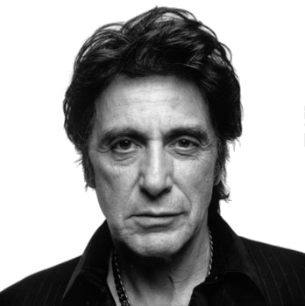



The Actor Model
Behaviour
Concurrency
State
Mailbox
Notes:
Actors have behaviour
Actors are objects that operate concurrently
Actors maintain their own state
Actors communicate via message passing
Actors have an address but not a location

Slide 40
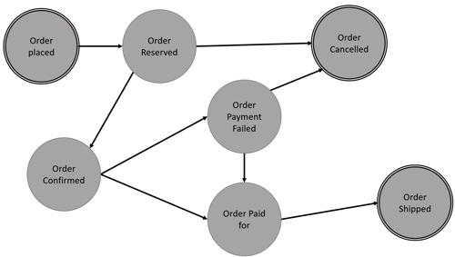
void PlaceOrder(Order order)
{
Send(new StartOrder(order));
}
void Handle(OrderCancelled orderId)
{
Send(new ReleaseStockCommand(Data.Items));
MarkAsComplete();
}
void Handle(StartOrder order)
{
Data.OrderState = State.Reserved;
Data.Items = order.Items;
Send(new ReserveStockCommand(Data.Items));
RequestTimeout(
new OrderConfirmed(order.Id),
DateTime.UtcNow.AddDays(1)
);
}
void Handle(PaymentSucceeded orderId)
{
Data.State = State.Paid;
Send(new ShipOrder(orderId));
}
void Handle(PaymentFailed orderId)
{
Send(new RequestNewPaymentInformation(orderId));
}
void Handle(OrderConfirmed orderId)
{
Data.State = State.Confirmed;
Send(new PackStockCommand(Data.Items));
Send(new ChargeCreditCard(orderId));
}
void Handle(ShipOrder orderId)
{
Data.State = State.Shipped;
MarkAsComplete();
}

Slide 41






Slide 42
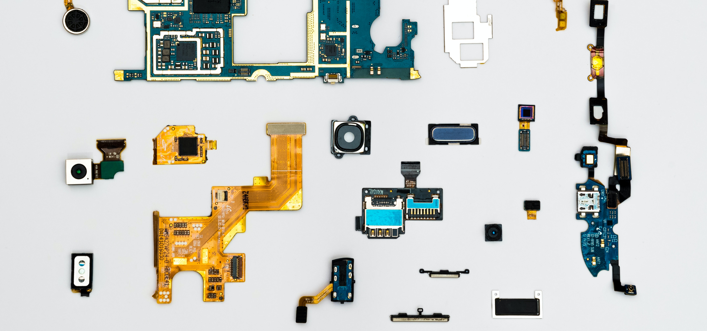
Third procrastination technique
Distributing state allows you to do as little as possible at each stage

Slide 43

Lazy, pre, or pro?
void AddItemToCart(Cart cart, Item item)
{
var amountOrderedInLastWeek = GetAccount().Orders()
.Where(o => o.OrderDate >= DateTime.UtcNow.AddDays(-7))
.Sum(o => o.OrderTotal);
if (amountOrderedInLastWeek + item.Price >= 100)
{
// 10% discount
item.Price *= 0.9m;
}
cart.Add(item);
database.Save();
}
{
Amount = R50
Item.Price = R30
Amount = R50
Item.Price = R40

Slide 44
Order Value →
Running Total
Date →

Slide 45
Let’s precrastinate!
void AddItemToCart(Cart cart, Item item)
{
var amountOrderedInLastWeek = GetAccount().TotalForLast7Days;
if (amountOrderedInLastWeek + item.Price >= 100)
{
// 10% discount
item.Price *= 0.9m;
}
cart.Add(item);
GetAccount().TotalForLast7Days += item.Price;
database.Save();
}
void AddItemToCart(Cart cart, Item item)
{
var amountOrderedInLastWeek = GetAccount().TotalForLast7Days;
if (amountOrderedInLastWeek + item.Price >= 100)
{
// 10% discount
item.Price *= 0.9m;
}
cart.Add(item);
GetAccount().TotalForLast7Days += item.Price;
RequestTimeout(
new ReduceWeeklyAmount(item.Price),
DateTime.UtcNow.AddDays(7)
);
database.Save();
}
Amount = R80
Item.Price = R36
Amount = R50
Item.Price = R30
Amount = R80
Item.Price = R40

Slide 46
void AddItemToCart(Cart cart, Item item)
{
var amountOrderedInLastWeek = GetAccount().TotalForLast7Days;
if (amountOrderedInLastWeek + item.Price >= 100)
{
// 10% discount
item.Price *= 0.9m;
}
cart.Add(item);
GetAccount().TotalForLast7Days += item.Price;
RequestTimeout(
new ReduceWeeklyAmount(item.Price),
DateTime.UtcNow.AddDays(7)
);
database.Save();
}
void Handle(ReduceWeeklyAmount reduction)
{
GetAccount().TotalForLast7Days -= reduction.Amount;
database.Save();
}

Slide 47

Fourth procrastination technique
Precrastinate and procrastinate at the same time

Slide 48
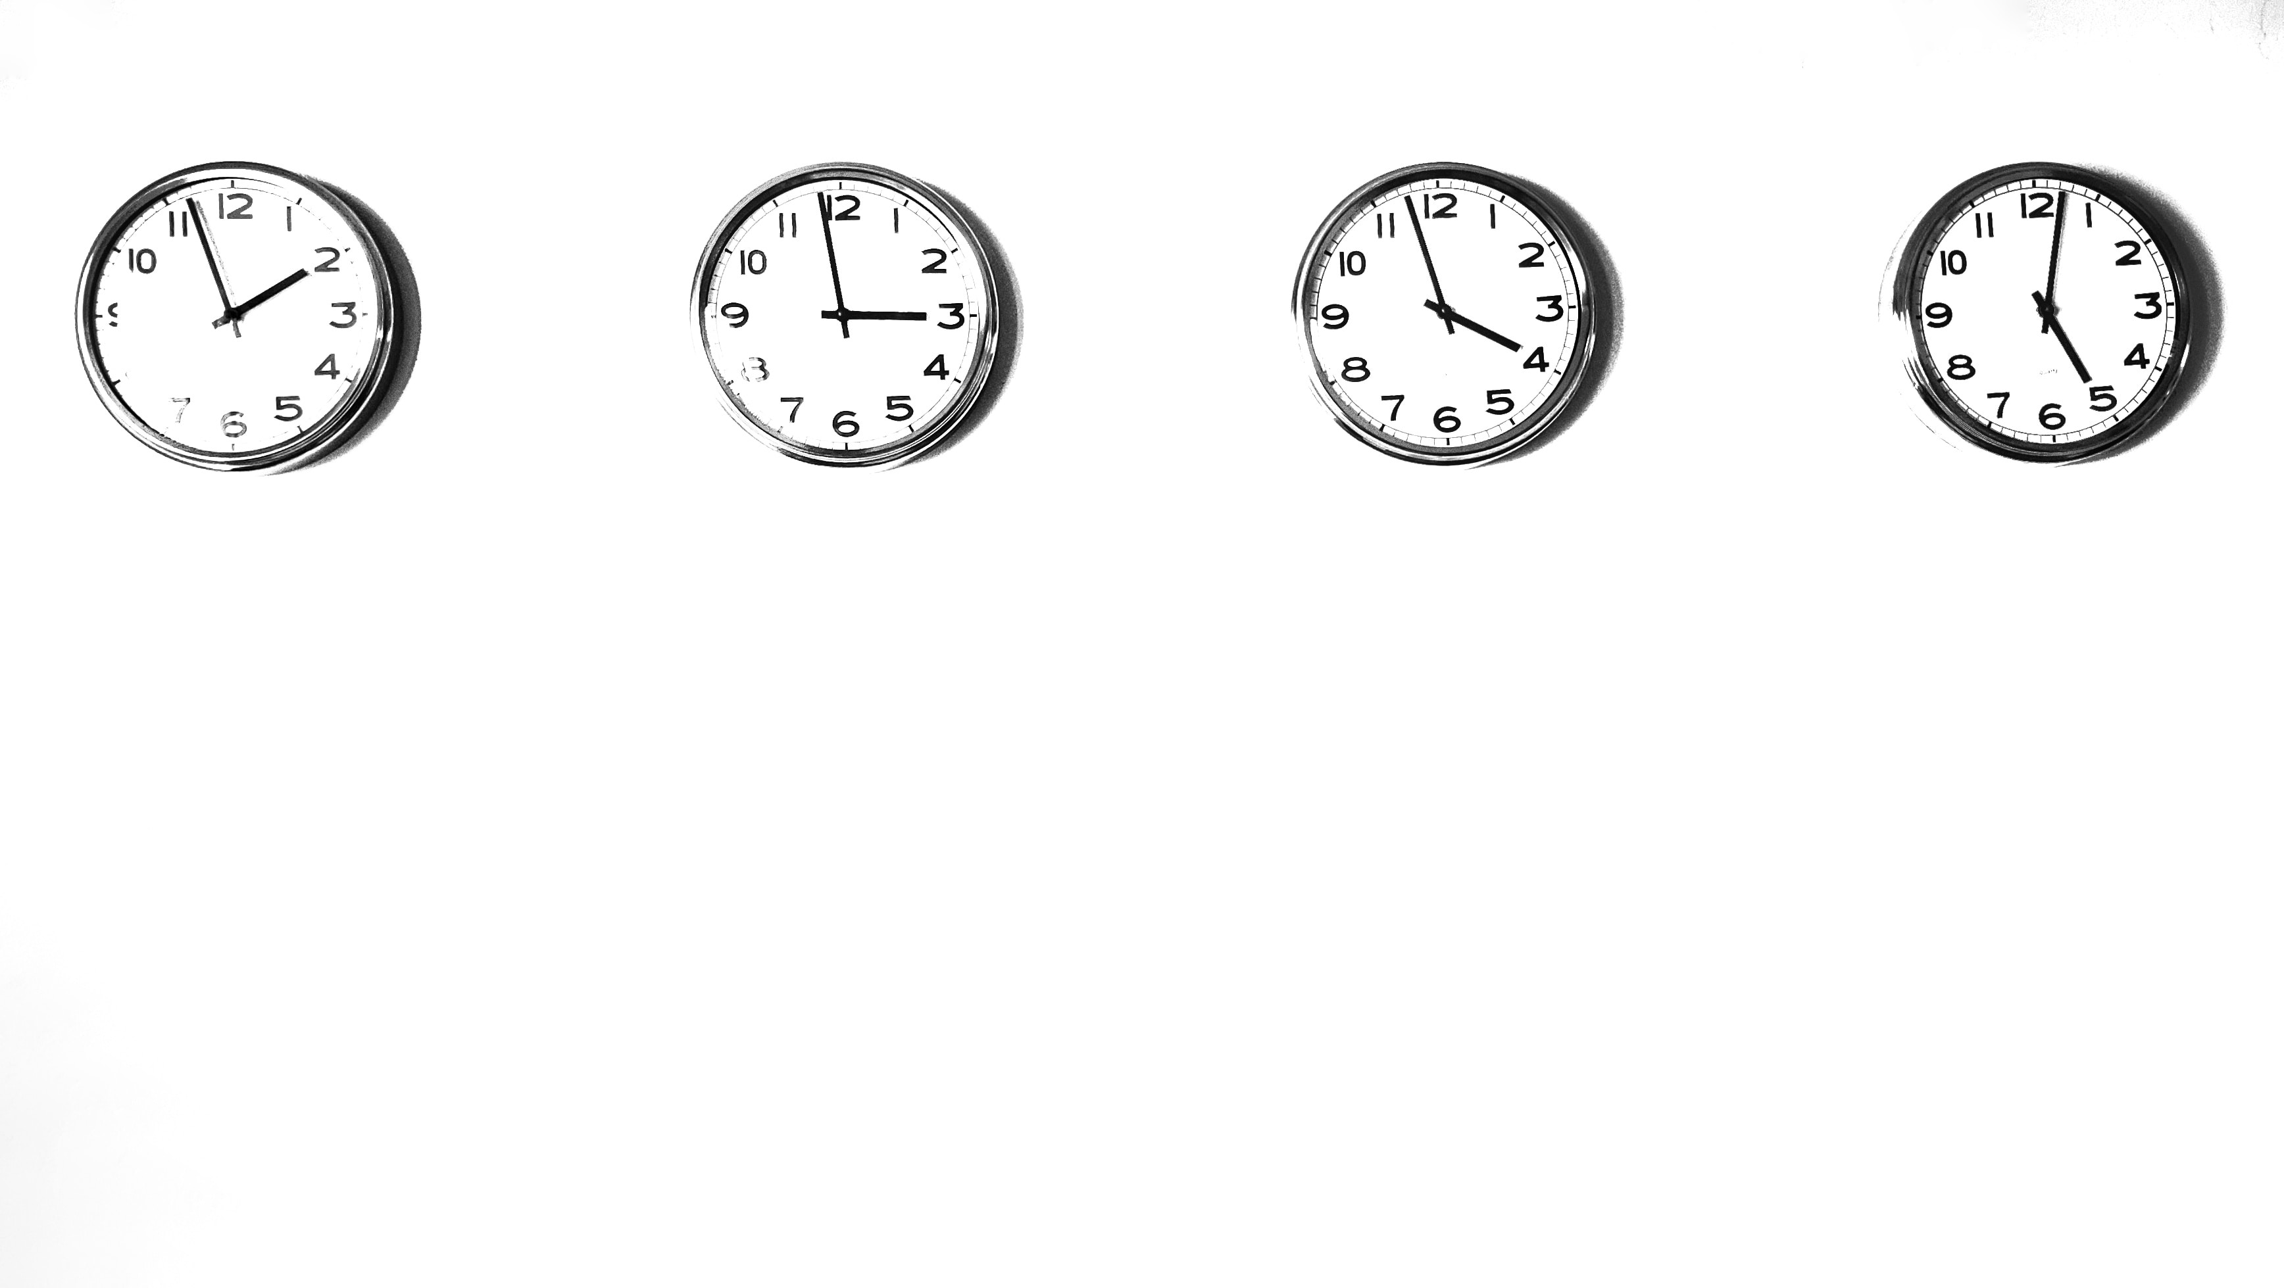
Treat “Time” as a first-class actor within your system design
Don’t use it everywhere – it doesn’t always make sense
Distribute state to let you do as little at each stage as possible
Combine precrastination and procrastination for fun side-effects

Slide 49
void CreateAccount()
{
// Save account details
[…snip…]
RequestTimeout(
new RemindUserTrialIsEndingSoon(),
DateTime.UtcNow.AddWeeks(1)
);
RequestTimeout(
new SetAccountToStandardTier(),
DateTime.UtcNow.AddDays(10)
);
}

Slide 50
void ScheduleVehicleMaintenance()
{
RequestTimeout(
new VehicleServiceDue(),
DateTime.UtcNow.AddMonths(6)
);
RequestTimeout(
new VehicleServiceDue(),
DateTime.UtcNow.AddMonths(12)
);
}

Slide 51
void BillingFailed()
{
SendFailedPaymentMail();
RequestTimeout(
new DeactivateAccount(),
DateTime.UtcNow.AddWeeks(1)
);
}

Slide 52
void Handle(RentalPlaced rental)
{
var customer = GetCustomer(rental.CustomerId);
var rentalTotal = customer.Rentals
.Where(r => r.RentalDate > cutoff)
.Sum(rental => rental.RentalValue);
customer.Preferred = rentalTotal >= 5000;
[…snip…] // do the rest of the rental
}
void Handle(RentalPlaced rental)
{
var customer = GetCustomer(rental.CustomerId);
customer.RentalTotal += rental.RentalValue;
customer.Preferred = customer.RentalTotal >= 5000;
RequestTimeout(
new ReduceCustomerRentalTotal(rental.RentalValue),
DateTime.UtcNow.AddYears(1)
);
[…snip…] // do the rest of the rental
}

Slide 53
References:
https://www.enterpriseintegrationpatterns.com/gregor.html
https://particular.net/blog/death-to-the-batch-job
https://www.developer.com/design/down-and-dirty-understanding-the-actor-model/
https://docs.particular.net/transports/rabbitmq/delayed-delivery

Slide 54
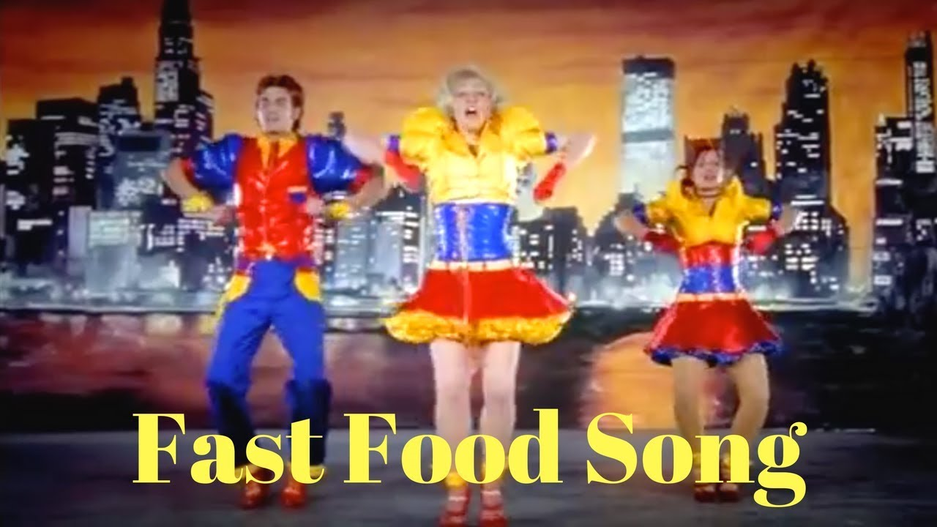
Who wants to see me dance?

